Slide 1
Geometry
Agenda
1. ENTRANCE
2. Go over Practice
3. 6-5 Trapezoids and Kites
4. Practice Assignment
5. EXIT

Slide 2
Practice WB 6-4 # 1-6, 12, 13, 17, 18

Slide 3
Discuss student conclusions
Discuss handout

Slide 4
Chapter 6
6-5 Trapezoids and Kites

Slide 5
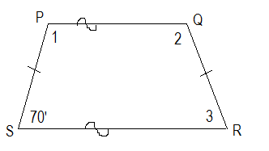
Example #1
Find the numbered angle measures.

Slide 6
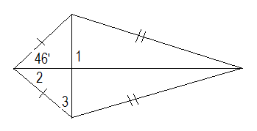
Example #2
Find the numbered angle measures.

Slide 7
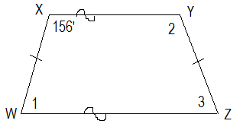
Example #3
Find the numbered angle measures.

Slide 8
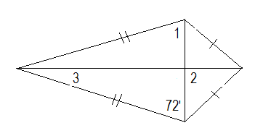
Example #4
Find the numbered angle measures.

Slide 9
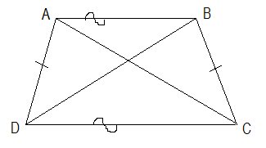
Example #5
Find the value of x.
AC = 4y + 6
BD = 7y - 3

Slide 10
Practice
WB 6-5 # 1-6, 8, 10-15, 17
EXIT

